Slide 1


Project/Product Mindset:
-ANUSHKA KATARIYA

Slide 2
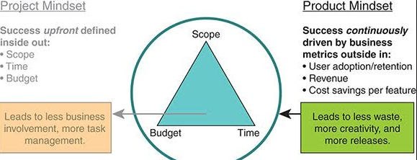
Project Mindset
Project is abbreviated as “pro” means before and “ject” means doing.
Project refers to a specific objective to create a product that is predefined with a clear start and end date.
Project essentially contained the planning part and the execution part.
Primary management is on the timeline and schedule.

Slide 3
Examples of Project Management
1) Purchasing a flat before construction ,you can construct it as per your guidelines and requirement.
2) Banking project like ICII,HDFC and e-commerce project like Flipkart and bigbasket.com.
These are specific to clients.

Slide 4
Role of a Project manager
Project managers are leaders—they not only ensure projects are delivered on time and in minimal budget, but must also engage, encourage and inspire their teams and clients.
The ultimate goal of a Project Manager is to maximize quality while minimizing the risk.
It manages the scope of the project, as they ensure time, cost, and quality. For example, if the deadline of a project is shortened, Project Managers must either increase costs or reduce the scope in order to maintain quality.

Slide 5
Responsibilities of a Project Manager
These are some of the core responsibilities that a project managers must handle :
Responsible for coming up with the plan.
Organizing and motivating a project team.
Controlling the time management .
Cost estimation and development of budget.
Ensuring customer satisfaction.
Monitoring Progress.
Managing reports and necessary documentation.
Test and Release the product.

Slide 6
What is Project Management?
A process is a series of actions performed by a team of people who work towards the same goal.
There are basically 5 types of project management processes:
Initiating: Requirements are gathered which are required for the project.
Planning: Creating a workable scheme that will include clearly defined activities, cost estimates, schedule development, and resource planning.
Executing: Carrying out the processes which are followed by regular information distribution and team development.
Monitoring and Controlling: Controlling quality of the project results, observing significant changes and making necessary adjustments to the project.
Closing: Gathering all the necessary data to ensure that the project is completed.

Slide 7
Product Mindset
A product is designed to continually create value for customers by solving their problems.
In product mindset, mainly we focus on the goal we want to achieve or the job to be done. We aren’t set on dates and timelines.
Product development is not a temporary or occasional endeavour. It is a continuous process of delivering new features and improving a given product over time.
A product can only be developed within the context of a project, and multiple projects can occur within a product’s life cycle.

Slide 8
Responsibilities of a Product Manager
Product Manager aims to maximize the value and create new revenue streams.
Understanding and representing of the user needs.
Monitoring the market and developing competitive analysis.
Defining a vision for a product.
Aligning stakeholders around the vision for product.
Prioritizing product features and capabilities.
Communicates product plans and strategies with management to obtain required decisions ,resources or management support and minimize surprises.
The Product Manager gathers needed customer feedback to guide making sound decisions for the project.
It manages the product life-cycle and determines when actions are needed to upgrade, improve, revise or reposition products, or when actions are needed to revise product promotional programs and product pricing.

Slide 9
What is Product Management?
Product Management can be defined as the general business structure within a company that supports and manages all the activities related to developing, marketing and selling a product.
Its goal is to deliver value to the business, product management professionals play a strategic role in determining the necessary actions for achieving these goals.
Product management’s general business purposes are to make the product value for its targeted customer while producing measurable benefits that make every business viable such as revenue, profit margins etc.

Slide 10
Project vs Product
A project has a defined beginning and end in time and is unique in that it is not a routine operation, but a specific set of operations designed to accomplish a singular goal and often includes people who don’t usually work together. At the end of a project, the team is usually disbanded and assigned to new projects with new team members.
On the other hand, a product is a good, service, platform, application, system, etc. that is created, maintained and supported by solving problems and providing benefits to specific customer and business needs. Products tend to be maintained by a stable group of individuals who do work together regularly and who bring in others as needed.

Slide 11

Digital Transformation:

Slide 12
What is Digital Transformation?
Digital transformation is the cultural, organizational and operational change of an organization, industry or ecosystem through a smart integration of digital technologies, processes and competencies across all levels and functions in a staged and strategic way.
While digital transformation is predominantly used in a business context, it also impacts other organizations such as governments, public sector agencies and organizations which are involved in tackling societal challenges such as pollution and aging populations by leveraging one or more of these existing and emerging technologies.

Slide 13
Trends In Digital Transformation.
Some of the digital transformation trends are listed as under:
CONNECTING THE CONSUMER EXPERIENCE: Consumer experience is the core of digital transformation initiative. A connected experience means removing friction in the customer journey, and being accessible anywhere, anytime.
DATA DRIVEN BUSINESS: Unlocking and analyzing data is at the heart of digital transformation. Businesses are putting their data to work to improve customer experiences, streamline operations, and quickly launch new products and services.
ARTIFICIAL INTELLIGENCE AND MACHINE LEARNING: Organizations are increasingly investing in AI capabilities to expedite and personalize customer service, reduce human bias, and increase productivity. They are learning that the value of AI and machine learning tools are dependent upon the data they are fed.

Slide 14
Key Factors for Digital Transformation
Leadership and culture
Value chain, partners and trends
Ability to implement the new technologies
Business intelligence and data science
Employee engagement
We might say that the focus of the digital transformation is on customer management and doing everything possible to deliver better customer experience.

Slide 15
Benefits of Digital Transformation
Digital Transformation helps in benefiting organizations by more number of returning customers and increased follow-up sales.
Increased productivity and improved customer satisfaction are the key factors.
The rapid adoption of the internet and Bring Your Own Device (BYOD) trend in the education industry have led to the growth of the digital transformation market across the globe in this vertical.
AI, Big Data and analytics, IoT and cyber-security has vastly enhanced the level of customer satisfaction in the sector of digital transformation.

Slide 16
Domains in IT

Slide 17
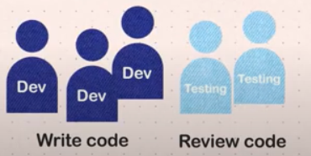
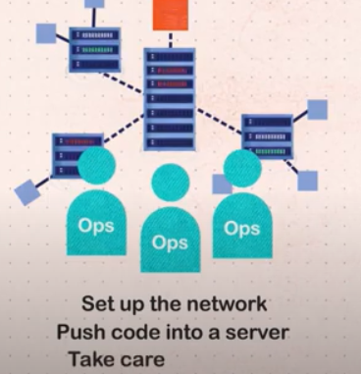
What is DevOps?
DevOps stands for Development and Operations. These are the set of practices that combines software development (Dev) and IT operations(Ops). It aims to shorten the systems development life cycle and provide continuous delivery with high software quality.

Slide 18
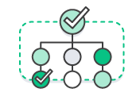
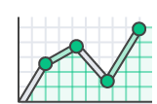
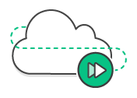

Benefits of DevOps
RELIABILITY
SPEED
SCALE
RAPID DELIVERY
SECURITY

Slide 19
Why Continuous Delivery?
Continuous delivery is an ongoing DevOps practice of building, testing, and delivering improvements to software code and user environments with the help of automated tools. The key outcome of the continuous delivery (CD) paradigm is code that is always in a deployable state.
Continuous delivery follows a streamlined process commonly known as the continuous delivery pipeline. The pipeline begins with the developer committing his code to the source repository. For every check-in, automated tests (unit, regression, performance, etc.) are run to ensure high-quality code. Once the code is verified, the executables are deployed automatically to an intermediate environment such as staging, integration, or UAT. At this point, the code is ready to go into production, and can be pushed live on-demand.

Slide 20
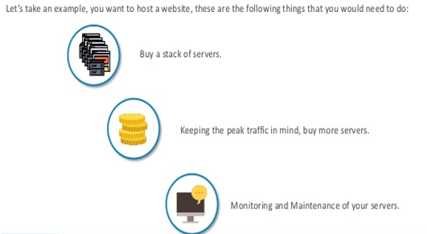
Before Cloud Computing

Slide 21
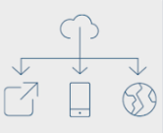
Why Cloud Computing?
Cloud computing is the on-demand delivery of IT resources via the internet, with pay as you go pricing. Instead of buying, owning and maintain physical data centers and servers you can access technology services, such as computing power, databases, storage on an as needed basis from a cloud provider like AWS.
Developing in the cloud enables users to get their applications to market quickly. Hardware failures do not result in data loss because of networked backups. Cloud computing uses remote resources, saving organizations the cost of servers and other equipment.

Slide 22
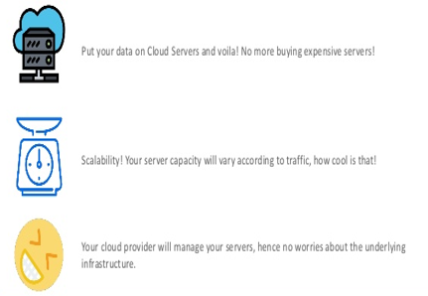
How it happens now?

Slide 23
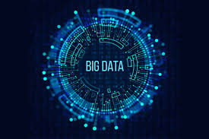
BIG DATA

Slide 24
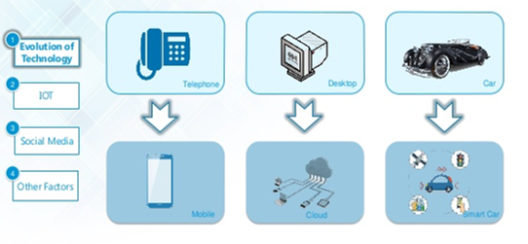
Evolution of Technology

Slide 25
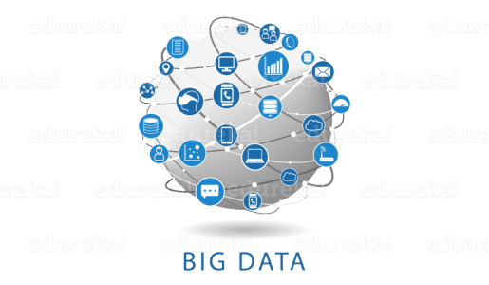
Why Big Data?
Big Data is a term that describes the large volume of data – both structured and unstructured – that inundates a business on a day-to-day basis. But it’s not the amount of data that’s important. It’s what organizations do with the data that matters. Big data can be analyzed for insights that lead to better decisions and strategic business moves.

Slide 26
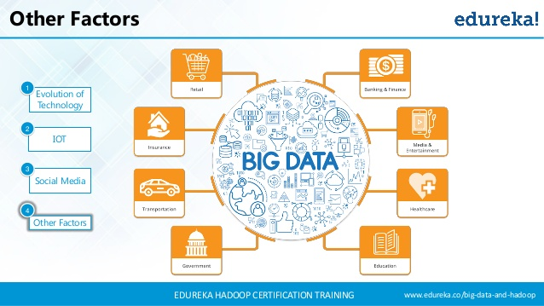
Factors of Big Data

Slide 27

Types of Big Data
Structured: The data that can be stored and processed in a fixed format is called as Structured Data. Data stored in a relational database management system (RDBMS) is one example of ‘structured’ data.
Semi-Structured: Data is a type of data which does not have a formal structure of a data model, i.e. a table definition in a relational DBMS, but nevertheless it has some organizational properties like tags and other markers to separate semantic elements that makes it easier to analyse. XML files or JSON documents are examples of semi-structured data.
Unstructured: The data which have unknown form and cannot be stored in RDBMS and cannot be analysed unless it is transformed into a structured format is called as unstructured data. Text Files and multimedia contents like images, audios, videos are example of unstructured data.

Slide 28
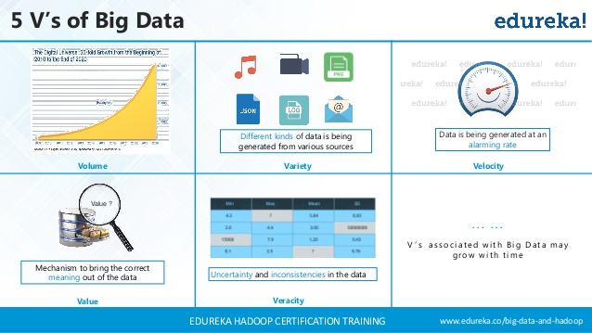
5 V’s Of Big Data

Slide 29
5 V’s Of Big Data
Volume: Organizations collect data from a variety of sources, including business transactions, smart (IoT) devices, industrial equipment, videos, social media and more. In the past, storing it would have been a problem – but cheaper storage on platforms like data lakes and Hadoop have eased the burden.
Velocity: This shows how fast the number of users are growing on social media and how fast the data is getting generated daily. If you are able to handle the velocity, you will be able to generate insights and take decisions based on real-time data.
Variety: As there are many sources which are contributing to Big Data, the type of data they are generating is different. It can be structured, semi-structured or unstructured. Hence, there is a variety of data which is getting generated every day.
Veracity: It refers to the data in doubt or uncertainty of data available due to data inconsistency and incompleteness.
Value: It is all well and good to have access to big data but unless we can turn it into value it is useless.

Slide 30
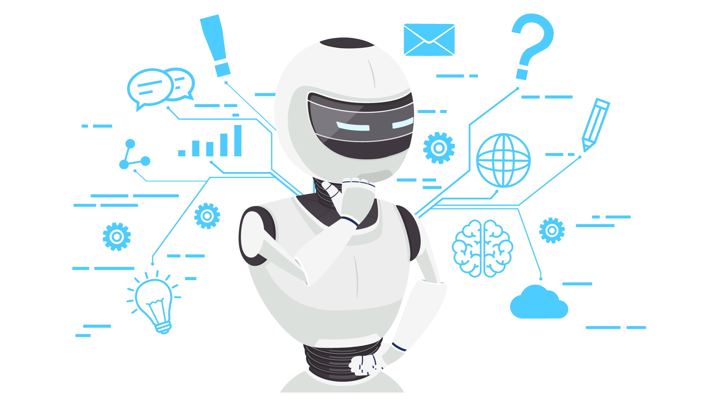
Artificial Intelligence

Slide 31
Why AI?
AI stands for Artificial Intelligence. AI is a set of algorithms and intelligence that try to mimic human intelligence.
Importance of Artificial Intelligence:
AI automates repetitive learning and discovery through data.
AI adds intelligence to existing products. For example, Siri was added as a feature to a new generation of Apple products. Automation, conversational platforms, bots and smart machines can be combined with large amounts of data to improve many technologies at home and in the workplace, from security intelligence to investment analysis.
AI adapts through progressive learning algorithms to let the data do the programming.

Slide 32
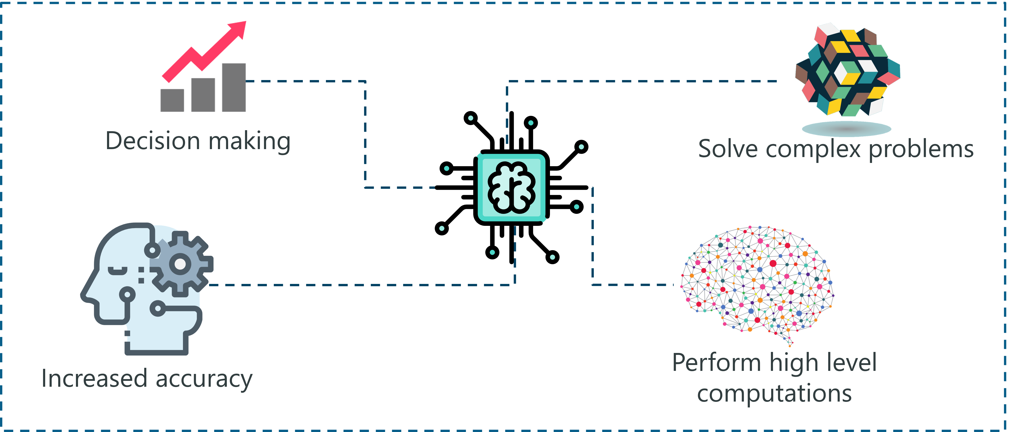
Benefits of AI
The terms are explained in the next slide:

Slide 33
Benefits of AI
Increased Automation: There are n number of AI-based applications that can be used to automate the recruitment process. Such tools help to free the employees from tedious manual tasks and allow them to focus on complex tasks like strategizing and decision making.
Increased Productivity: Artificial Intelligence has become a necessity in the business world. It is being used to manage highly computational tasks that require maximum effort and time.
Smart Decision Making: One of the most important goals of Artificial Intelligence is to help in making smarter business decisions.
Solve Complex Problems: AI has helped companies solve complex issues such as fraud detection, medical diagnosis, weather forecasting and so on with help of Machine Learning algorithms to advanced machine learning concepts such as Deep Learning.

Slide 34


